Slide 1
STEGANOGRAPHY
CAPSTONE PROJECT
Presented By:
Student Name : YUVA VARSHITH VANAMA
College Name & Department : IIIT NAGPUR, CSE

Slide 2
OUTLINE
Problem Statement
Technology used
Wow factor
End users
Result
Conclusion
Git-hub Link
Future scope

Slide 3
Problem Statement
secure data hiding in images using steganography.
*Steganography is the practice of concealing secret data within an image
*This method allows secure transmission of sensitive information without raising suspicion.
The program should allow users to select an image, encrypt a secret message using pixel manipulation, and save the modified image.
It should also enable decryption by extracting the hidden message upon entering the correct passcode.

Slide 4
Technology used
*PYTHON, PYTHON LIBRARIES(OPENCV,NUMPY), GIT, GITHUB
*pip install opencv-python prompt in windows command panel.

Slide 5
Wow factors
Python-Based GUI – This project implements image steganography using Python with Tkinter, making it lightweight and easy to use.
Integrated Image Processing – The program directly manipulates pixel values using libraries like Pillow and NumPy, ensuring efficient image handling.
User-Friendly Interface – The GUI-based system offers file selection, real-time status updates, and message pop-ups, making encryption/decryption more accessible.
Cross-Platform Support – The application runs seamlessly on Windows, macOS, and Linux, with minimal dependencies and easy installation via pip.
Efficient Encoding Mechanism – Uses RGB pixel manipulation to embed messages without noticeable image distortion, ensuring high security and data integrity.

Slide 6
End users
1. Cybersecurity Enthusiasts & Researchers – Individuals exploring data hiding techniques and secure communication methods.
2. Journalists & Whistleblowers – People who need to hide sensitive information inside images for secure transmission without raising suspicion.
3. Students & Educators – Those learning about steganography, cryptography, and Java image processing in computer science courses.
4. Forensic Experts & Law Enforcement – Investigators analyzing hidden messages in digital images for cybercrime detection.
5. Privacy-Conscious Users – General users who want to securely share messages without using traditional encryption methods that might attract attention.
6. Military – Military personnel involved in covert operations who require secure, concealed communication for exchanging classified information without raising suspicion, even when using untrusted or public communication channels.

Slide 7
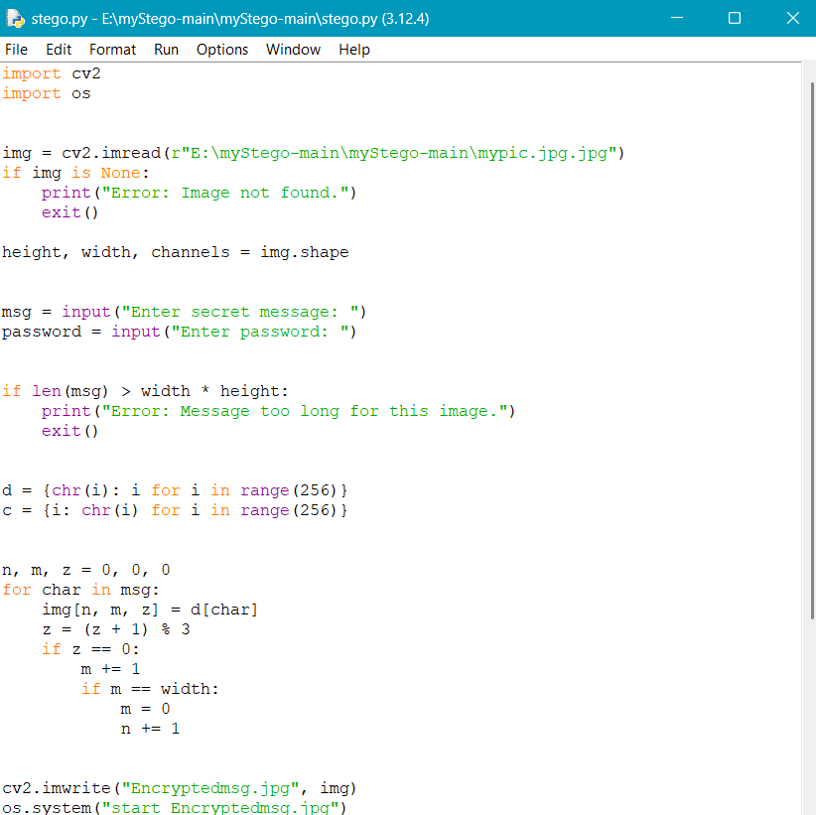
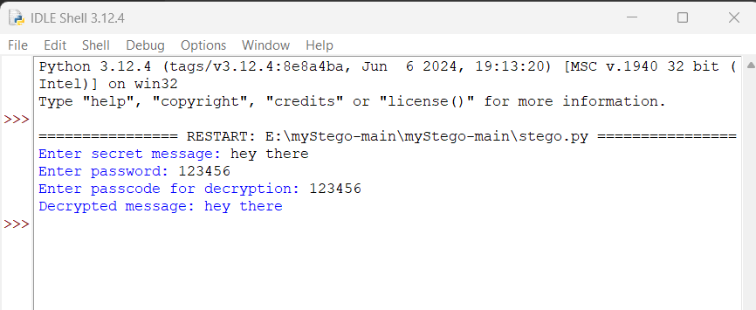
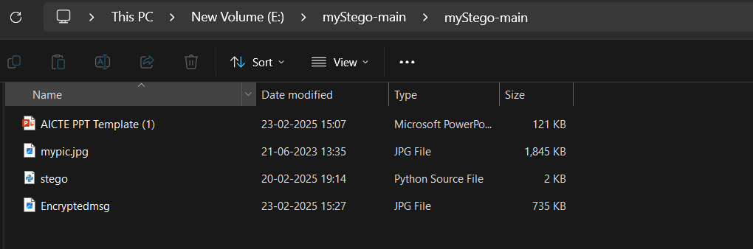
Results

Slide 8
Conclusion
This project showcases the use of Python-based image steganography to securely hide and retrieve messages within images. With a user-friendly GUI and cross-platform support, it provides a simple yet effective solution for secure communication. Whether for cybersecurity experts, military use, or privacy-conscious individuals, this tool ensures that sensitive information remains protected. The integration of image manipulation and encryption principles makes it a valuable asset in real-world security applications.

Slide 9
GitHub Link
https://github.com/YuvaVarshith4/PROJECT_EDUNET.git

Slide 10
Future scope(optional)
Advanced Encryption Techniques – Integrating more sophisticated encryption algorithms like AES or RSA for added security in message encoding and decoding.
Steganography in Video – Expanding the project to embed messages in video files, providing an even more discreet medium for secure communication.
Mobile Application – Developing a mobile version of the tool for Android or iOS to allow users to easily perform steganography directly from their smartphones.
File Type Support – Enhancing the tool to support a wider range of file formats, such as PNG, BMP, or TIFF, for greater flexibility.
Watermarking Integration – Incorporating digital watermarking techniques for both image security and copyright protection in sensitive content.
Real-time Messaging – Allowing real-time encryption and decryption of messages exchanged through live video or streaming platforms.

Slide 11
THANK YOU

